Slide 1
Alamo AFCEA
Connecting People, Ideas and Solutions Globally
Rick Lipsey
President, Alamo Chapter
March 2020
President@AlamoAFCEA.org
(210) 718-2371

Slide 2
AFCEA is a Connecting Organization
Our World is Changing
Will We Withstand It?
Or Lead It?
Workshops
Socials
Panels
Joint
Events
Connecting People, Ideas and Solutions Globally

Slide 3
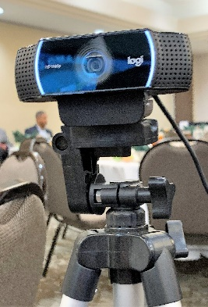
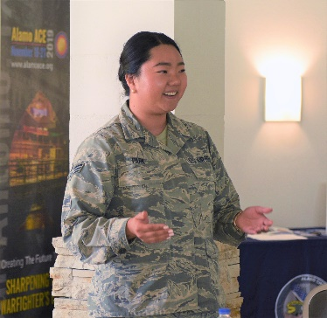
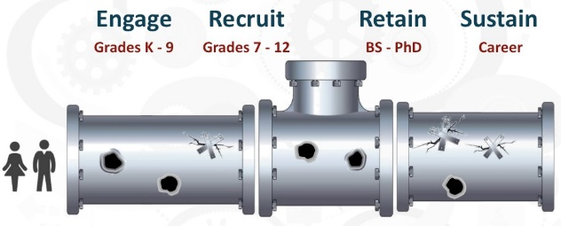
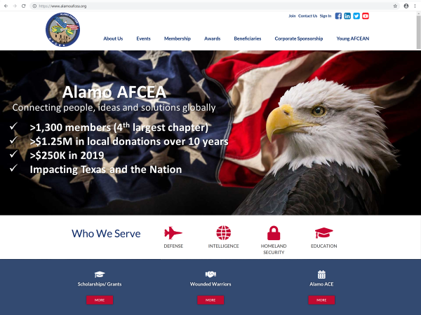
Reinforcing Our Value Prop
Outreach
OPERATION:
Members Only Services
Community Calendar
Continuing Education
Corporate Directory
Member Directory
Job Board
One-touch event registration
Focused Mentoring
Connecting People, Ideas and Solutions Globally

